Slide 1
Things you should know!
Pick up an ICI sheet!
Today’s attendance is… a Sign-In Sheet!
Check the Slack!!!

Slide 2
Week 4!
CMSC389O: The Coding Interview

Slide 3
Today
Arrays, arrays, arrays...
In Class Interviews (ICI)

Slide 4
Arrays
One of the most important topics for programming interviews
Most companies ask array questions at some point
String problems can be structured like Arrays
Usually the first data structure people learn about
Has specific upper and lower bounds (i.e. IndexOutOfBoundsException)
Can be iterated through very easily
Has lots of neat tricks to make your life easier, if you look closely!

Slide 5
Types of Problems
Properties of Arrays (Does this array contain X? How do you check if…)
2D Matrices, ND Arrays
ArrayList (“endless” array; can be added to)
Character Arrays (Strings)
Missing Elements
Sorting & Searching
Serializing
Efficiency

Slide 6
Things to Think About
Is this array already sorted?
Does this array have any negative values? Does that affect my solution?
Can I sort it, and still have the most efficient solution? (Better than O(nlogn)?)
Did I check my upper and lower bounds?
Would traversing in reverse make it more efficient?
Can I keep track of values in O(1) space? O(n) space?
Edge cases!

Slide 7
Edge Cases
Empty sequence
Sequence with 1 or 2 elements
Sequence with repeated elements
If you encounter elements that are not allowed
What to return in these cases

Slide 8
Types of Solutions
Sliding Window Technique
Fast i, slow j
Mergesort, Quicksort, Heapsort (O(nlogn) sorts)
Use Array Elements as Index (Bijection from ℕ → Elements)
Straight run through
Looping

Slide 9
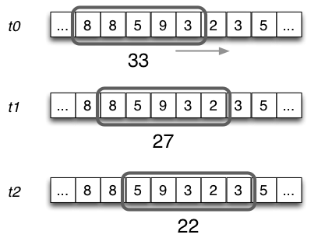
Sliding Window
Used to get a contiguous subsequence of an array
Questions like:
“Given an array of size n and a number k, find the minimum summation of k elements.”

Slide 10
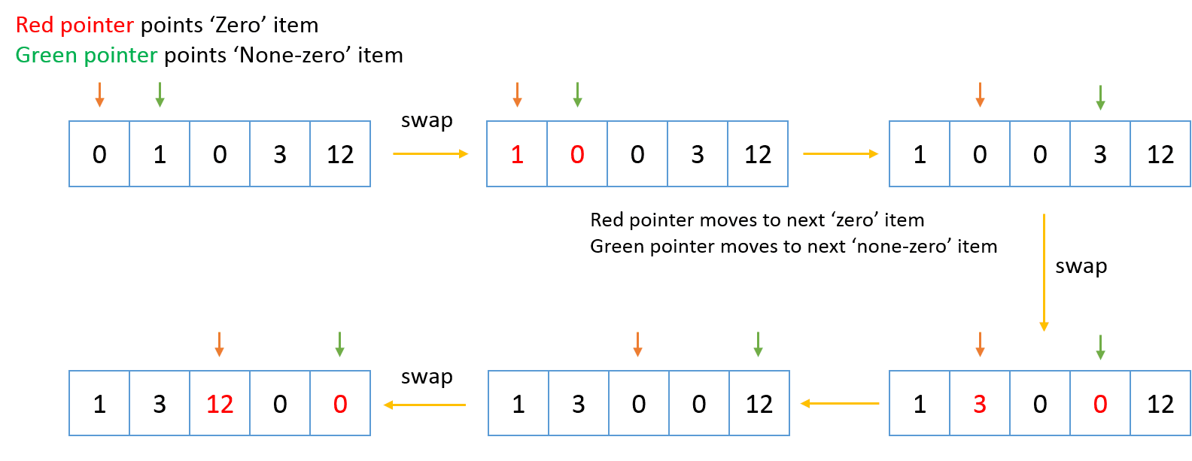
Fast i, Slow j
Variation of Sliding Window
Has a reaching i, and a stationary j
Good for in-place modification of an array

Slide 11
Mergesort, Quicksort, Heapsort
Will discuss next week!
Important parts of each:
Mergesort - Merge action - For huge datasets | Quicksort - Partition - Close to Binary Search, with specific size on each side | Heapsort (♥) - Heapify - Can use MinHeap or MaxHeap to get k number of Min/Max elements of array

Slide 12



Use Array Elements as Index
Create a new array (O(k) extra space), and store TRUE (1) or FALSE (0) in the indices whose values correspond with the element you are keeping track of
OR use your original array (O(1) extra space) to mark presence of an element x by changing the value at the index x to negative
Acts like a flag!
Start array at 1 for easier application
Check out Counting Sort! :-)

Slide 13
In-Class Interviews
Match up with someone who has a DIFFERENT question than you!
(Hint: There are only two questions to be asked…)

Slide 14
Reminders
Fill out feedback form at http://ter.ps/f9h !
Career Fair!!!
February 20, 2018
4PM - 8PM
Seniors start at 3PM
COLLEGE PARK MARRIOTT HOTEL & CONFERENCE CENTER
https://cs.umd.edu/cscareerfair/students for more information!

Slide 15
HW1 From Last Week...
We’ve updated GitHub with the correct Space and Time Complexities
Scale:
-2 for less than O(n) time complexity for part 1
Common mistake: sorting array
-2 for less than O(1) space complexity for part 1
Common mistake: using Hashset or other data structure
-2 for less than O(n) time complexity for part 2
Brute force solution
-2 for less than O(1) space complexity for part 2

Slide 16
Homework Due for Next Week
https://github.com/UMD-CS-STICs/389Ospring18/blob/master/HW3_Arrays.md

Slide 17
Feedback:
Pros
Positive feedback about HW
Positive feedback about ICIs
Cons
Clerical errors
Things to change
Adding time/space complexity to HWs
More time for ICIs

